Slide 1

Web Based Blood Management System

Slide 2

Presented by
Md. Sakib
ID: 193002086
Muhammad Ahshan Sharif
ID: 193002054
Department of CSE
Green University of Bangladesh

Slide 3

Introduction
Blood bank is a place where blood bag that is collected from blood donation events is stored in one place. The term “blood bank” refers to a division of a hospital laboratory where the storage of blood product occurs.

Slide 4

Objectives
To Improve Blood donating non-Technical system.
To avoid touts between donor and blood receiver.
To improve donor searching process.

Slide 5
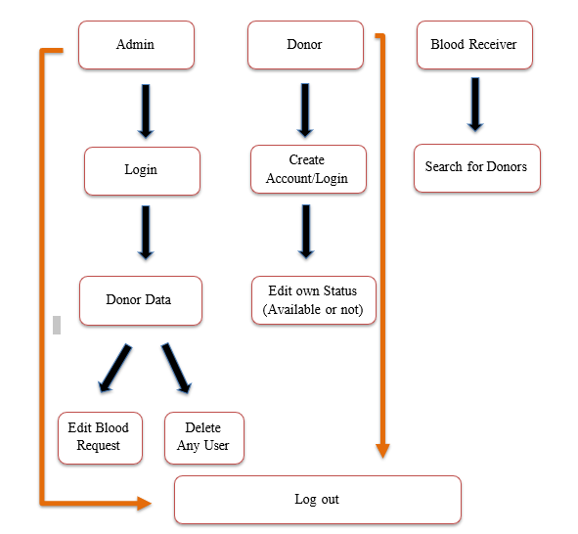
Current Structure

Slide 6
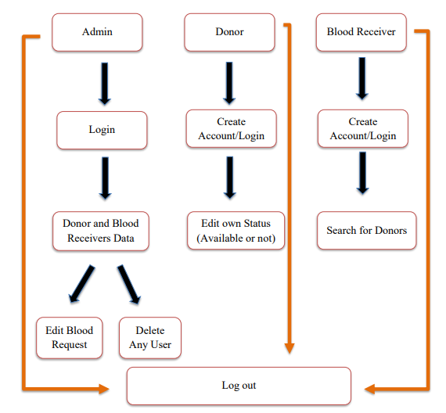
Aimed Structure

Slide 7

Conclusion
Blood Bank Management System is a management system that is developed to manage blood donating system online. The BBMS had been developed in accordance to donor and blood receiver requirement. This is to make sure that the management of the blood stock became effective, systematic and meeting user requirements.

